Slide 1
Lab 7: The Sampling Distribution of the Sample Mean
STAT 201: Elementary Statistics
Shan Zhong

Slide 2
Students will work in groups of 2.
Uses computer simulations to illustrate theories of sampling distribution of the sample mean.
Open Rstudio
We will create simulations per each of the following distributions:
Exponential
Uniform
Standard Normal

Slide 3
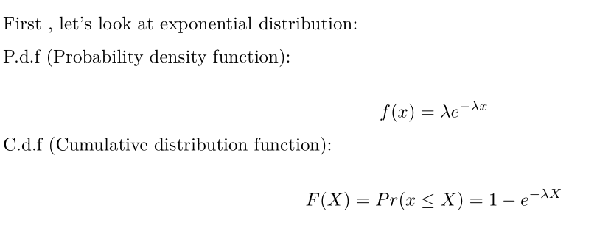
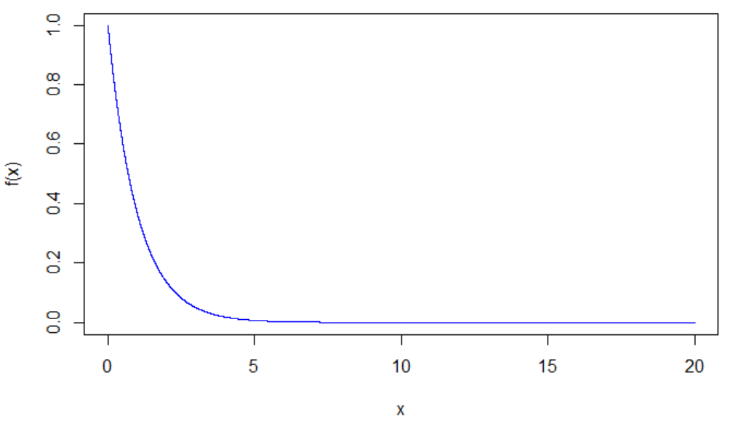
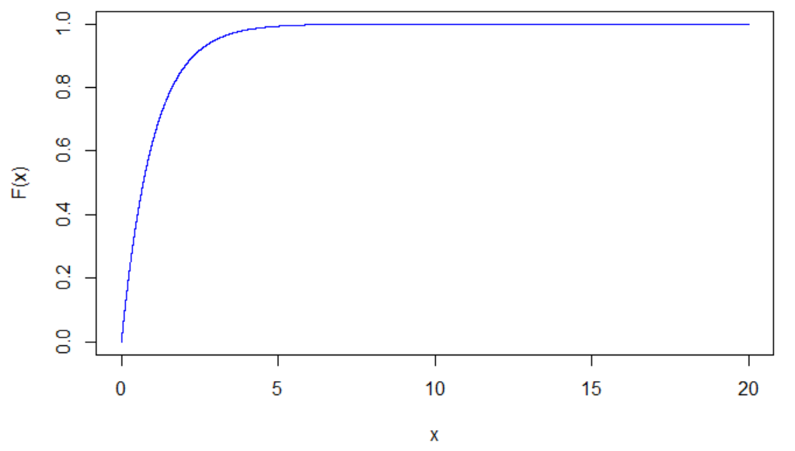

Slide 4
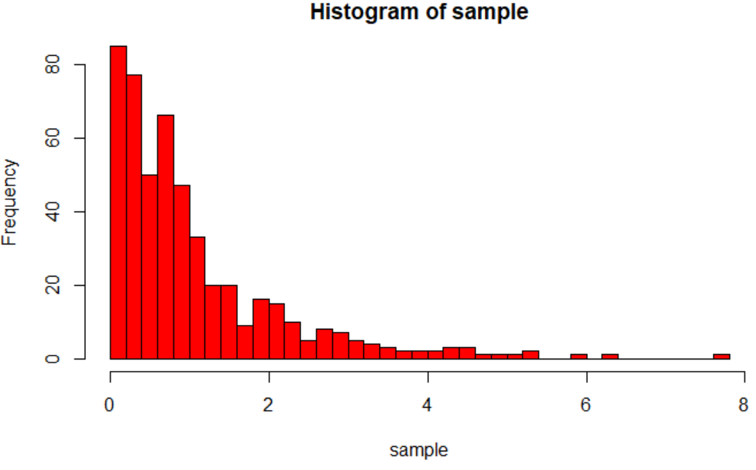
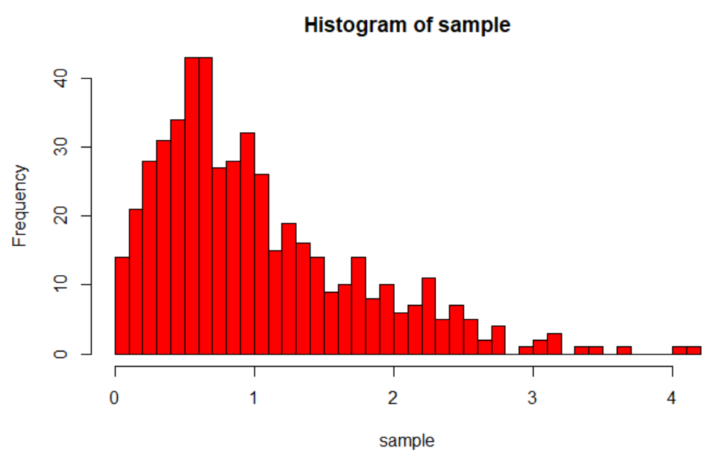
Exponential distribution are usually used to model waiting time between independent events. Such as waiting time for passenger entering airport, waiting time to call customer service. Also , some material’s half life have an exponential distribution.
Let’s see how it’s mean is distributed:
When n = 2:

Slide 5
Understanding What the Data in the First Set of Output we Generated Represents
This is a Population Distribution:
The distribution of the population data – all data value from every item in the population.
The x-axis on the histogram provided tells us what the data values in the entire population are.
Since the mean and standard deviation were calculated for the entire population these values are parameters.

Slide 6
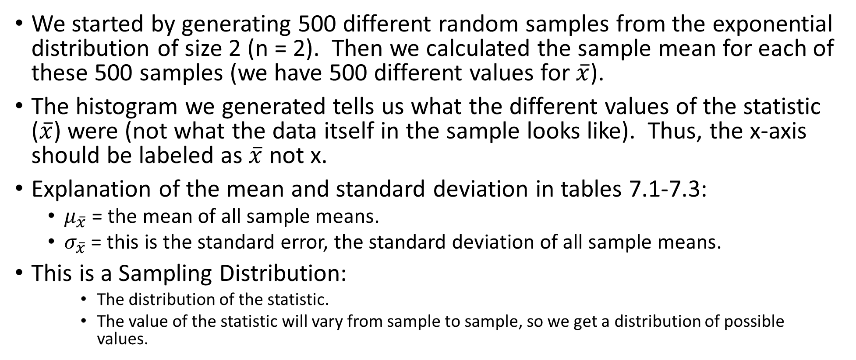
Understanding What the Data in the Second Set of Output we Generated Represents
We started by generating 500 different random samples from the exponential distribution of size 2 (n = 2). Then we calculated the sample mean for each of these 500 samples (we have 500 different values for $\overline{x}$).
The histogram we generated tells us what the different values of the statistic ($\overline{x}$) were (not what the data itself in the sample looks like). Thus, the x-axis should be labeled as $\overline{x}$ not x.
Explanation of the mean and standard deviation in tables 7.1-7.3:
$μ_{\overline{x}}$ = the mean of all sample means.
$σ_{\overline{x}}$ = this is the standard error, the standard deviation of all sample means.
This is a Sampling Distribution:
The distribution of the statistic.
The value of the statistic will vary from sample to sample, so we get a distribution of possible values.

Slide 7
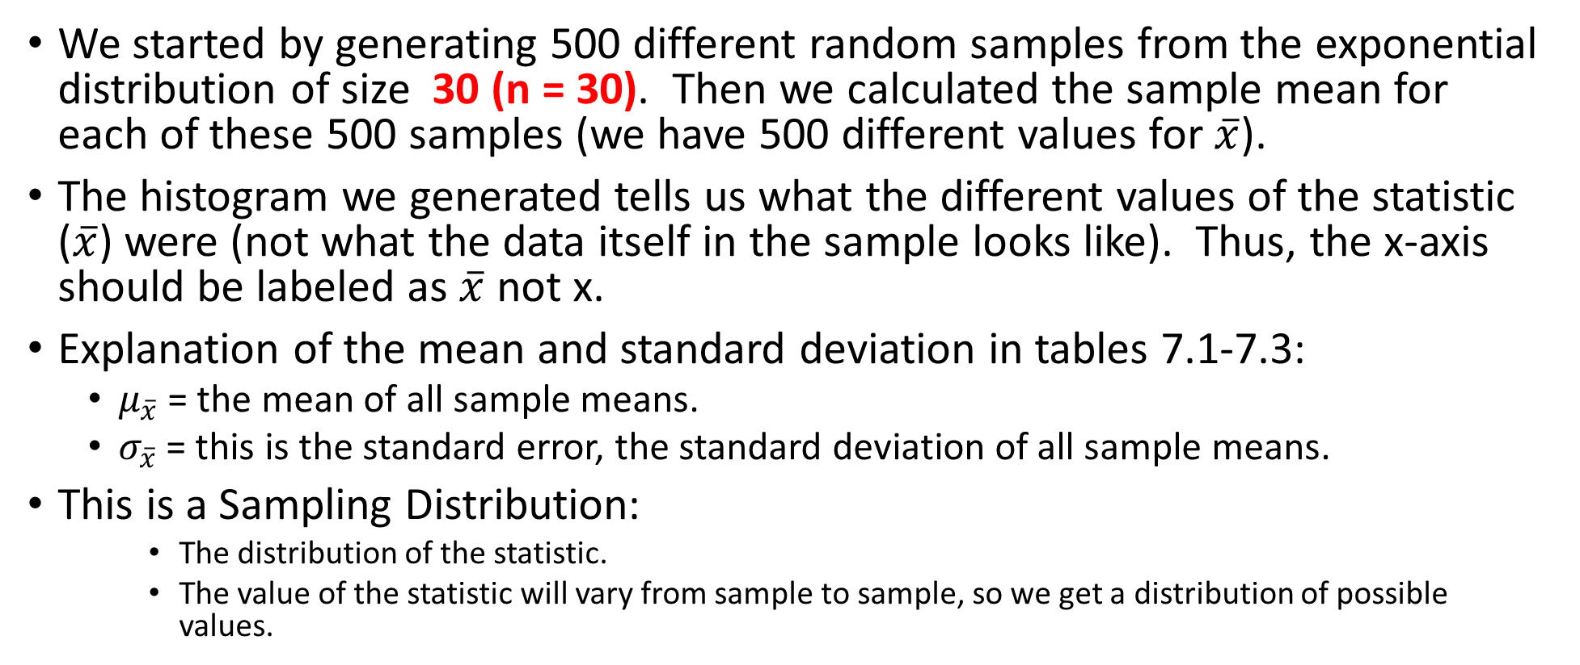
Understanding What the Data in the Third Set of Output we Generated Represents
We started by generating 500 different random samples from the exponential distribution of size 30 (n = 30). Then we calculated the sample mean for each of these 500 samples (we have 500 different values for $\overline{x}$).
The histogram we generated tells us what the different values of the statistic ($\overline{x}$) were (not what the data itself in the sample looks like). Thus, the x-axis should be labeled as $\overline{x}$ not x.
Explanation of the mean and standard deviation in tables 7.1-7.3:
$μ_{\overline{x}}$ = the mean of all sample means.
$σ_{\overline{x}}$ = this is the standard error, the standard deviation of all sample means.
This is a Sampling Distribution:
The distribution of the statistic.
The value of the statistic will vary from sample to sample, so we get a distribution of possible values.

Slide 8
Generate Your Output
Follow the steps on the Lab7.pdf provided.
You will need to have tables 7.1 – 7.3 completed on page 55.
You will need copies of the following 9 graphs in a Word Document:
Exponential Distribution: Population Distribution, Sampling Distribution (n = 2), Sampling Distribution (n =30).
Uniform Distribution: Population Distribution, Sampling Distribution (n = 2), Sampling Distribution (n =30).
Standard Normal Distribution: Population Distribution, Sampling Distribution (n = 2), Sampling Distribution (n =30).

Slide 9
Discussion Question Notes
1. The lab book gives you an overview of the central limit theorem and if you read this information and look at the histograms for n=30 you should be able to answer this question with minimal help. (page 51)
2. Make sure you notice that the question is only asking about the standard normal population.
3. You need to do the calculation and compare it to your findings in table 7.3.
4. This question you may need help with. Look at the original shape and determine if you had to physically rearrange the graph to look normal which would require more work to transform to approximately normal. Basically if the graph was large blocks and you had to rearrange the blocks into the normal distribution which would require more work.
5. Read the reality check.

